Slide 1


Great Colleges
to Work For 2025
September 2025

Slide 2

Overview
Surveyed 628 employees in March 2025, 49% (308) participated.
Administrators: 89%
Professional Staff: 66%
Support Staff: 40%
Faculty: 49%
Notes:
Administered by ModernThink, LCC
199 colleges participated – 123 4-year and 76 2-year
Almost 120,000 employees participated

Slide 3

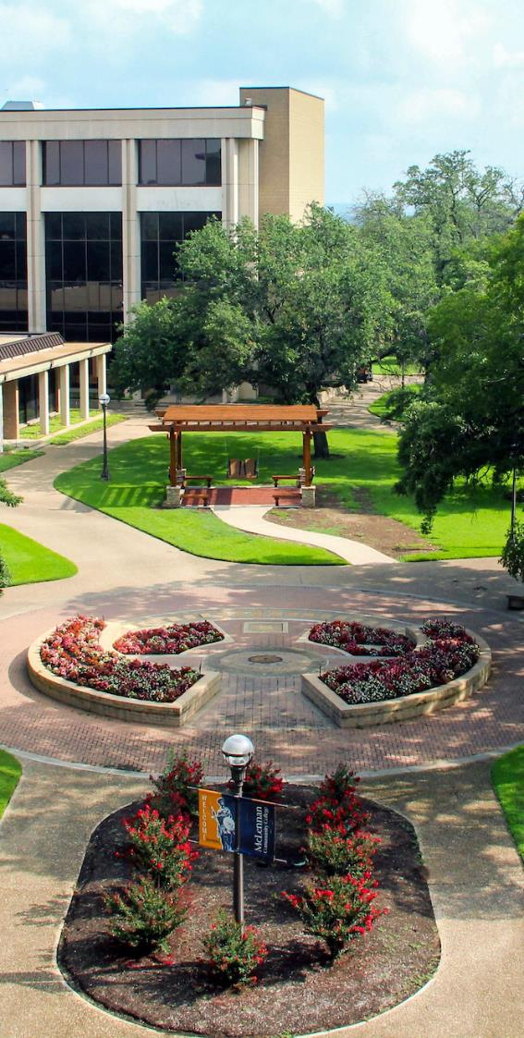







Recognition

Slide 4
Recognized in Texas –
2-Year Institutions
Lone Star College System
McLennan Community College
Navarro College
Panola College
Notes:
Four-Year Institutions
Abilene Christian University
Angelo State University
Baylor University
Lamar University
Texas Tech University
University of Texas Rio Grande Valley
University of the Incarnate Word

Slide 5
Overall Positivity Rating
88% - Mission & Pride
85% - Faculty & Staff Well-being
84% - Inclusion, Belonging & Community
83% - Job Satisfaction & Support
80% - Supervisor/Department Chair Effectiveness
78% - Professional Development
75% - Confidence in Senior Leadership
73% - Collaboration
68% - Communication
61% - Performance Management
Notes:
49% Response Rate – lower than past years of ~53%
2025 Recognition in Compensation and Benefits

Slide 6
1-Year Point Difference
 | 2025 | 2024 | +/-
Mission & Pride | 88% | 88% | -
Faculty & Staff Well-being | 85% | 84% | +1
Inclusion, Belonging & Community | 84% | 81% | +3
Job Satisfaction & Support | 83% | 84% | -1
Supervisor/Department Chair Effectiveness | 80% | 83% | -3
Professional Development | 78% | 80% | -2
Confidence in Senior Leadership | 75% | 74% | +1
Collaboration | 73% | 72% | +1
Communication | 68% | 68% | -
Performance Management | 61% | 62% | -1
Overall Percent Positive | 78% | 78% | -

Slide 7
Highlights
94% - I understand how my job contributes to this institution's mission.
92% - The work I do is meaningful to me.
88% - All things considered, this is a great place to work.
90% - I am proud to be part of this institution.
90% - My job makes good use of my skills and abilities.

Slide 8
Areas of Improvement
59% - Changes that affect me are discussed prior to being implemented.
58% - I am regularly recognized for my contributions.
64% - Our recognition and awards programs are meaningful to me.
67% - There are sufficient opportunities to participate in institutional planning.
67% - I am paid fairly for my work.

Slide 9
Questions

