Slide 1


Student Success
Update
October 2025

Slide 2


Strategic Planning
Increasing student economic mobility through attainment of credentials of value and transferability.
Identifying and developing resources to improve student outcomes and support systems, to streamline processes, and to create efficiencies across the institution.

Slide 3
Overarching Goal of the Strategic Plan
McLennan Community College will increase fall to fall retention of first time in college students by 10%.

Slide 4
Retention Baseline
Fall 2024 – Fall 2025
First Time in College Retention
61.7%

Slide 5
What is a 10% increase?
61.7%
67.9%
Notes:
It is not 10 percentage points, but 10%. If we were to increase 10 percentage points, that is actually a 16% increase.

Slide 6
Much More than Just Retention
Total Enrollment Growth
Developmental Education Completion
Overall Course Completion Rates
Just in time Communications
Student Touchpoints
Scheduling and Advising
Programmatic Offerings
Online Education

Slide 7

True Up Funding
+$1,021,960
Notes:
Additional FY25 Settle Up funding

Slide 8
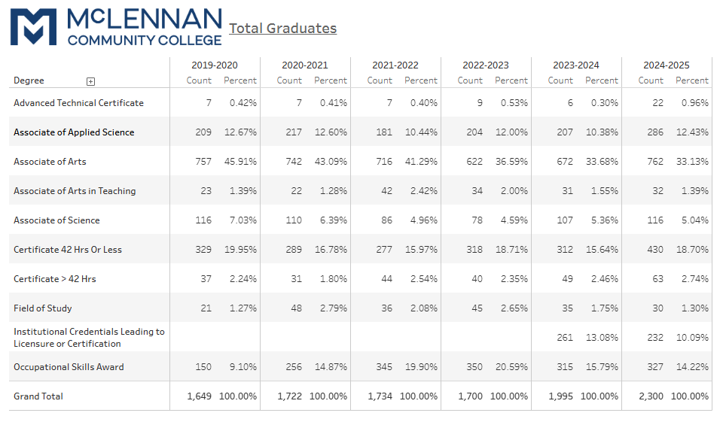
+14.2%
Notes:
33% increase since 2019-2020

Slide 9
Notes:
33% increase since 2019-2020

Slide 10
Licensure Pass Rates
100% Pass Rate
Law Enforcement Academy
Long Term Care Administration
Medical Assistant
Occupational Therapist Assistant
Respiratory Therapist Assistant
Radiologic Technology
Associate Degree Nursing
Licensed Vocational Nursing
Real Estate
90%+ Pass Rate
Cosmetology
Fire Academy
Physical Therapist Assistant
Emergency Medical Tech
Medication Aide
Truck Driving/CDL
Notes:
Out of 20 programs with licensure requirements or options, 9 achieved 100% pass rates, and another 6 achieved over 90%.

Slide 11
Job/Education Placement Rates
100% Placement Rate
Data Processing Technology
Child Development
Paralegal
Law Enforcement Academy
Fire Academy
Health Information Technology
Veterinary Technology
Emergency Medical Tech
Radiologic Technology
Respiratory Care Technology
Medical Lab Technician
Associate Degree Nursing
Operations Management
Accounting
Notes:
Job and Education Placement rates look at if a graduate is employed or is enrolled in higher education by the fall following graduation.

Slide 12
Job/Education Placement Rates
90+% Placement Rate
Microcomputer Applications
Teacher Education
Long Term Care Administration
Medical Assistant
Occupational Therapist Assistant
Physical Therapist Assistant
Mental Health & Social Work
Massage Therapy
Real Estate

Slide 13
Questions

