Slide 1
SIMPSON AND TRAPEZOID RULE VIA JAVA
By: Amadou Fall

Slide 2
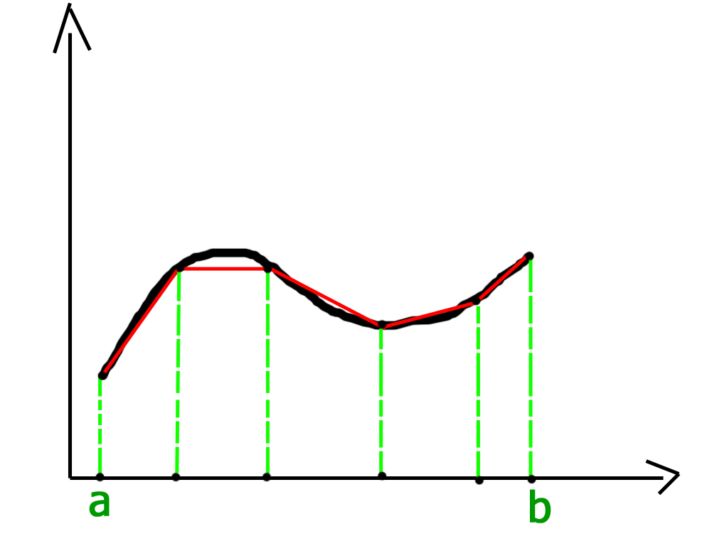
Trapezoid rule
Trapezoidal rule is used to find the approximation of a definite integral. The basic idea in Trapezoidal rule is to assume the region under the graph of the given function to be a trapezoid and calculate its area.

Slide 3
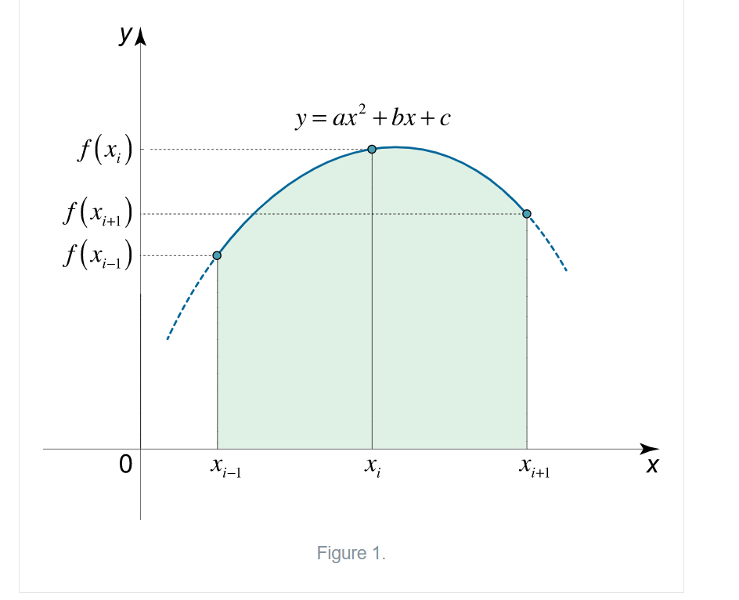
Simpson Rule
Simpson’s rule is a method for numerical approximation of definite integrals.

Slide 4
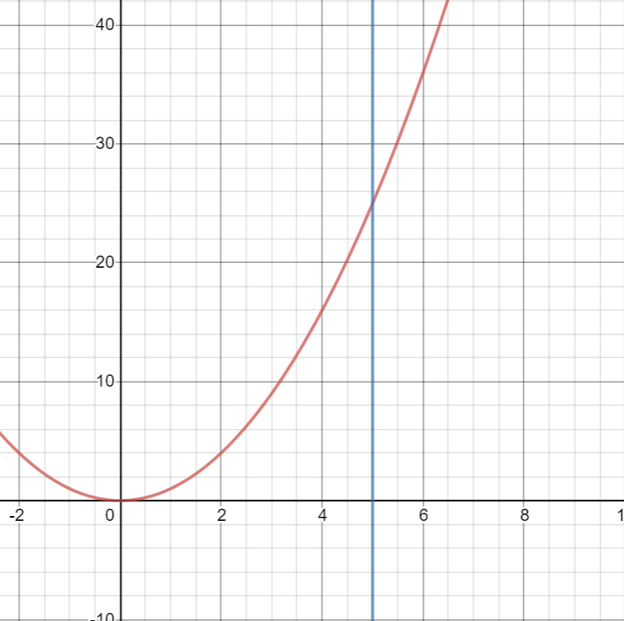
f(x)=x²

Slide 5
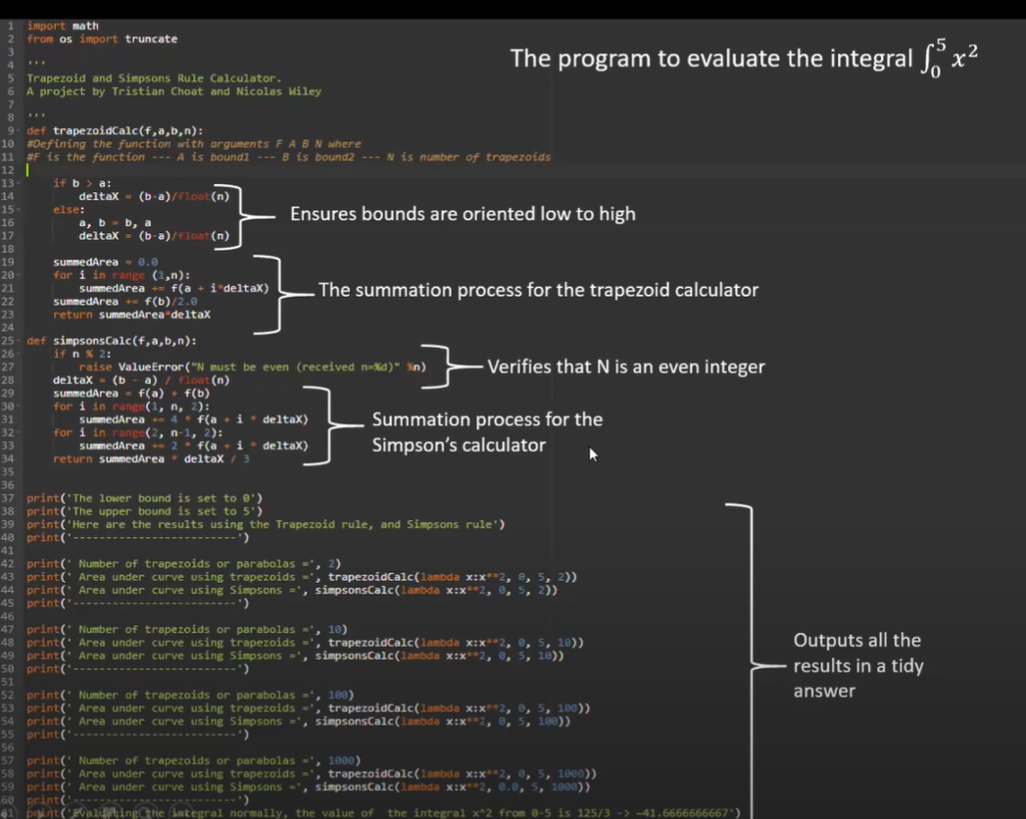
We first start by initializing variable they swap variables .cant do a = b , and b = a
Temp a
Temp b
Variables so you can swap them (JAVA
You define a function using def and open it using a colon . Everything must be indented
Python doesn’t use types it uses the variables

Slide 8
Works Cited
https://www.khanacademy.org/math/ap-calculus-ab/ab-integration-new/ab-6-2/a/understanding-the-trapezoid-rule
https://www.math24.net/simpsons-rule/#:~:text=For%20n%3D4%20subintervals%2C%20Simpson's,f(x4)%5D.
https://www.youtube.com/watch?v=hmAqYIThdxQ&feature=youtu.be&t=1012

