Slide 1
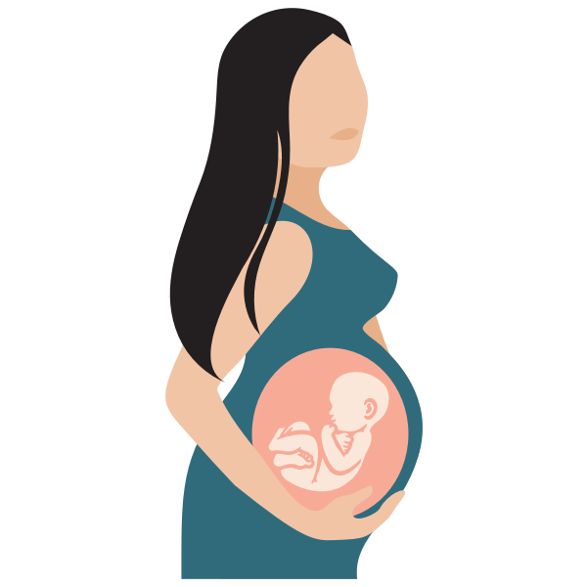
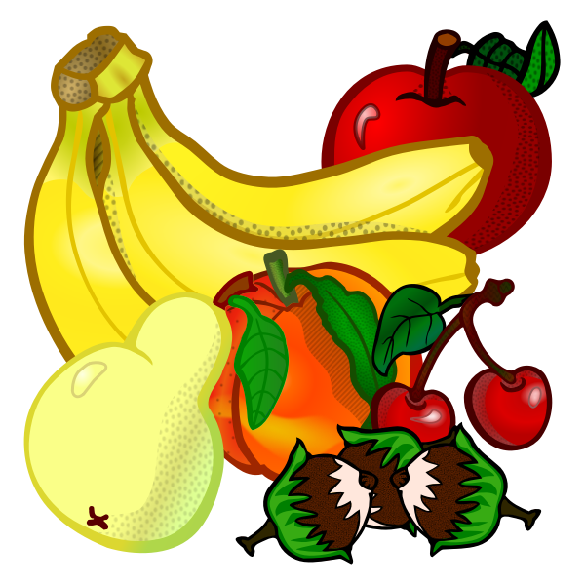
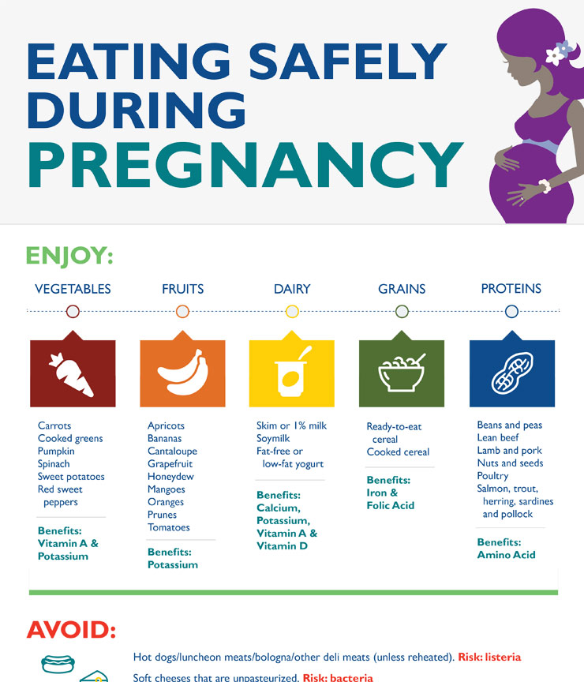


Nutrition During Pregnancy
By: Bre’asia Hackworth, Judith Sarinana, Reyna Sheehan, and Michelle Walsh
Vegetables 3-5 Servings | Fruits 2-4 Servings | Dairy 3-4 Servings | Grains 9-11 Servings | Proteins 4 Servings | Fats < 4 Servings
+Carrots +Cooked Greens +Pumpkin +Spinach +Sweet Potatoes +Red sweet peppers | +Apricots +Bananas +Cantaloupe +Grapefruit +Honeydew +Mangoes +Oranges +Prunes +Tomatoes +Grapes | +Skim +1% milk +Soymilk +Low-fat yogurt +Cottage cheese +Tofu | +Ready-to-eat cereal +Cooked cereal +Baked chips +Whole wheat pasta or brown rice +White potatoes | +Bean and peas +Lean Beef +Lamb and pork +Nuts and seeds +Poultry +Salmon, trout, herring, sardines, and pollocks +Eggs | +Peanut butter +Olive/Canola Oil +Avocado +Butter +Mayonnaise
Benefits: Vitamin A & Potassium | Benefits: Potassium | Benefits: Calcium, Potassium, Vitamin A & Vitamin D | Benefits: Iron & Folic Acid | Benefits: Amino Acid
Notes:
Fats should be no greater than 4 servings

Slide 2


What should be limited?
Seafood containing mercury
  Limit to less than 12 ounces per week
Caffeine
  Limit the caffeine you get each day to less than 200 milligrams
  Caffeine is commonly found in coffee, tea, energy drinks, chocolate, soda and some over-the-counter medicine
What should be avoided?
Raw or undercooked meats
Raw fish, especially shellfish
Raw/lightly cooked eggs or foods made with them
  This can include cookie dough, Caesar salad dressings, eggnog or certain sauces like hollandaise.
Unpasteurized milk and foods made with unpasteurized milk
Alcohol
Non Food items, like clay, starch, paraffin or coffee grounds.
  Tell your provider if you crave anything like this that’s not food.
Notes:
Seafood: By eating fish that contain mercury, you can pass the metal to your baby during pregnancy. This can cause brain damage and affect your baby’s hearing and vision.
Alcohol: There is no known safe amount of alcohol to drink while you’re pregnant.

Slide 3
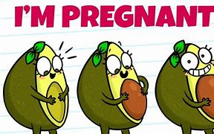
Why you should eat healthy during pregnancy?
For the Mother:
Appropriate weight gain for the mother
Can reduce pregnancy symptoms such as fatigue and morning-sickness
Reduces risk of anemia
For the Baby:
Healthy Birth Weight
Reduced risk of birth defects
Good fetal brain development

Slide 4
References
  Foods to avoid or limit during pregnancy. (2020, March). Retrieved November 05, 2020, from
https://www.marchofdimes.org/pregnancy/foods-to-avoid-or-limit-during-pregnancy.aspx.
  Nutrition During Pregnancy. (n.d.). Retrieved November 05, 2020, from
https://www.hopkinsmedicine.org/health/wellness-and-prevention/nutrition-during-pregnancy

